Slide 1
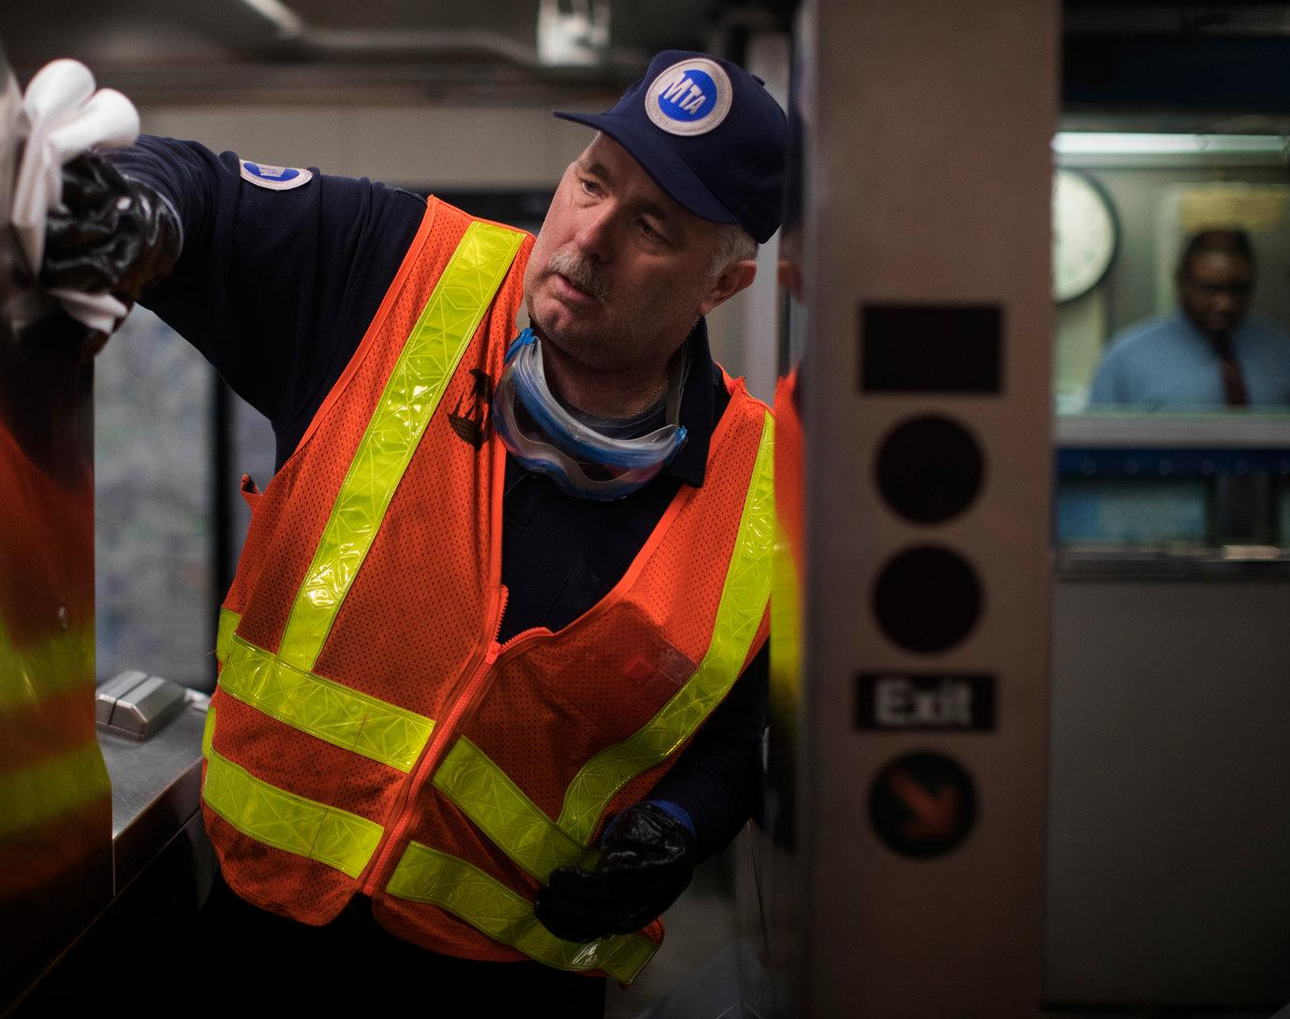
Exploration of MTA Subway Ridership
Zheyu(Joree) Liu
Notes:
Hi everyone, I’ll start my presentation.

Slide 2
Baseline Model
Variables (7) | Explanation
Major Incidents | Incidents that delay 50 or more trains
Service Delivered | The percentage of scheduled trains that are actually provided during peak hours.
Terminal On-Time Performance | The percentage of trains arriving at their destination terminals as scheduled.
Number of Scheduled Trips | Total number of scheduled trips.
Escalator Availability | The percent of time that escalators are operational systemwide.
Customer Journey Time Performance | Estimated percentage of customers’ trips that are completed within 5 minutes of the scheduled time.
Additional Platform Time | Estimated average time that customers spend waiting at a station beyond their scheduled wait time.
Notes:
My baseline model includes 7 variables, all of them come from the MTA dashboard.

Slide 3
Explanation Diagnostics
Variables | Coefficient | p-value
Major Incidents | 0.0129 | 0.933
Service Delivered | 587.6088 | 0.101
Terminal On-Time Performance | 27.8465 | 0.679
Number of Scheduled Trips | 0.0007 | 0.000
Escalator Availability | 78.8003 | 0.568
Customer Journey Time Performance | -525.2129 | 0.031
Additional Platform Time | -36.3123 | 0.244
F-statistics | 7.443 | <0.01
Intercept | -147.9556 | 0.722
R²- adj | 0.617
PRESS | 910.407
Prediction Diagnostics
Total Prediction Error | 60.299
Mean Prediction Error | 8.614
Mean Squared Error | 125.637
Notes:
Here are the results for the baseline model. The p-value for the F-test is smaller than 0.01, meaning that this model fits the data better than the model with no independent variables at the significant level of 0.99. The R2 adj is 0.617, meaning that the model explains 62% percent of the variance. The coefficients of variables that highlighted in pink pass the t-test.
For the prediction diagnostics, three required parameters are calculated. We cannot speak much about these parameters but they are useful for the later comparison with our advanced models.

Slide 4
lI. Candidate Regressors
 | New Variables | Explanation
FHV Data | Trips Per Day | Average number of trips recorded each day
 | Farebox Per Day | Total amount, across all vehicles, collected from all fares, surcharges, taxes, and tolls
 | Unique Drivers | The total unique number of hack drivers who recorded a trip each month
 | Unique Vehicles | The total unique number of medallion taxis/SHLS/FHVs and standby vehicles who recorded at least one trip in the month
 | Vehicles Per Day | The average unique number of medallion taxis/SHLS/FHVs and standby vehicles* who recorded at least one trip in a day
Population | Population | Monthly population for the NYC metro area (in millions)
Notes:
Besides the performance variables from MTA dashboard, I also added 5 variables “for hire vehicles” datasets, because fhv are usually considered as competitors of public transportation and numerous studies show that FHV, including uber, lyft and taxi have become increasingly popular these years. The FHV variables include trips, drivers, farebox and vehicles to capture the trend of FHV usage. What’s more, monthly population for the NYC metro area is also added.

Slide 5
Type | New Variables | Explanation
Time-delayed | * | Variables and delayed periods are determined by cross-correlation method.
Interaction | Number of Scheduled Trips && Additional Platform Time | Interaction between number of schedule trips and additional platform time
 | Terminal On-Time Performance && Additional Platform Time | Interaction between number of terminal on-time performance and additional platform time
PCA component | First component | Explains 60.3% variance of the data
 | Second component | Explains 15.1% variance of the data
Transformed | * | Standardized all variables (they are largely sparse datasets)
Notes:
For now we have 13 variables including MTA performance variables, population and FHV variables. Then I used cross correlation method to select variables and transformed them with specific time period into time delayed variables. Also, two interactions variables and two pca variables were added. Finally, I standardized all the variables since they are largely sparse.

Slide 6
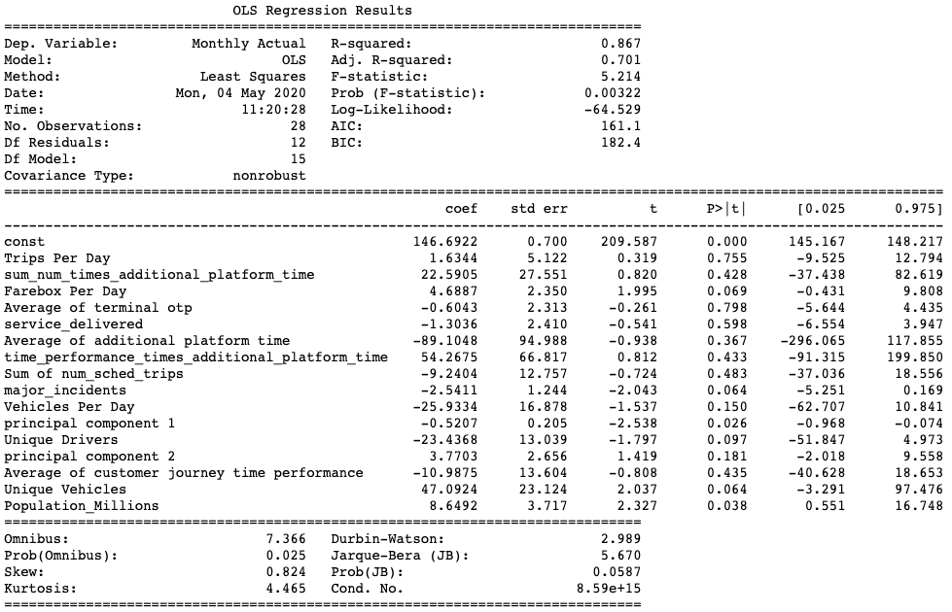
lII. Model Exploration
Stepwise regression
Notes:
Then we proceed to the model exploration.
For the step-wise regression, I don’t have the list of every t and p value for each regressor each step at hand yet so I pasted the results of the final selected model. When we set the alpha in equals 0.5 and alpha out equals 0.5, it did throw anything out. Compared with the baseline model, the adjusted r2 increases, suggesting a better fit. However, only three out of sixteen variables pass the t-test.

Slide 7
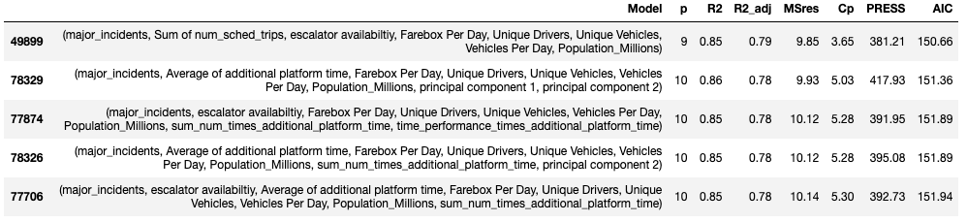
All possible regression -- by AIC
Notes:
Since there are 16 variables in total, so the all possible regressions process generated more than 10,000 possible combinations, making it impossible to show a comprehensive list of summary. Therefore I only show the summary of top 5 regressions sorted by AIC. The first regression model has the lowest AIC.

Slide 8
lV. Final Models
Model | Criterion | # of Variables | multicollinearity | outliers | R2-adj | Bias
A | Smallest AIC | 8 | ✕ | 1 | 0.785 | 9.85
B | Second Smallest Mallows’s Cp | 7 | ✕ | 1 | 0.752 | 11.38
C | Second Largest R2-adj | 9 | ✕ | 1 | 0.783 | 9.92
* Since the model A also has smallest Mallows’s Cp statistics and largest adjusted R2, the B and C models are selected based on the second smallest Mallows’s Cp and second largest R2-adj.
Notes:
I selected three final models A, B and C based on the results of all possible regressions. They are chosen for different reasons. Model A has the smallest AIC, Model B has the second smallest Mallows’s Cp, and Model C has the second largest r2-squared because the model A also has smallest Mallows’s Cp statistics and largest adjusted R2. I compared some performance parameters here and we can see there’s not much difference among them. (Mean squared error is calculated to compare bias)

Slide 9
V. Prediction Performance
Expected ranking | Model | Reason
1 | A | Smallest AIC and Mallows’s Cp, largest R2-adj
2 | C | Second largest R2-adj
3 | B
4 | Baseline | Smallest R2-adj
Notes:
Model a is expected to have the best performance because it’s Explanation Diagnostics show best results among all the variables. The baseline model is expected to have the worst prediction performance because it has the smallest r2 and so primitive that no time-lag and interaction terms in it.

Slide 10
V. Prediction Performance
Expected ranking | Model | Reason | Actual Ranking
1 | A | Smallest AIC and Mallows’s Cp, largest R2-adj | 2
2 | C | Second largest R2-adj | 3
3 | B |  | 1
4 | Baseline | Smallest R2-adj | 4
Notes:
However, the actual ranking is very different though the baseline model still the worst model as I expected. Model B with the second largest adjusted R2 has the best prediction performance.

Slide 11
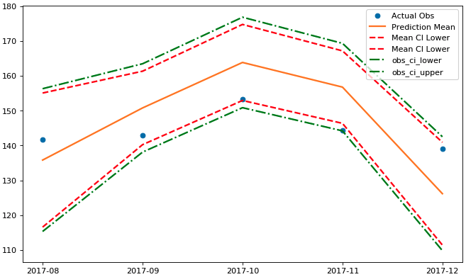
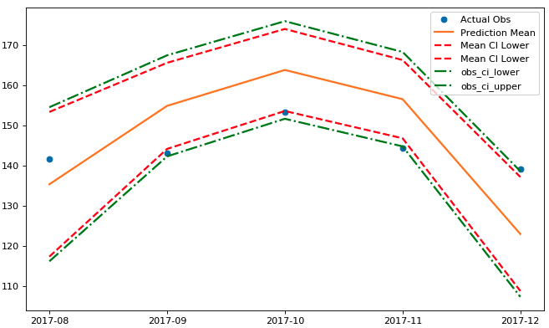
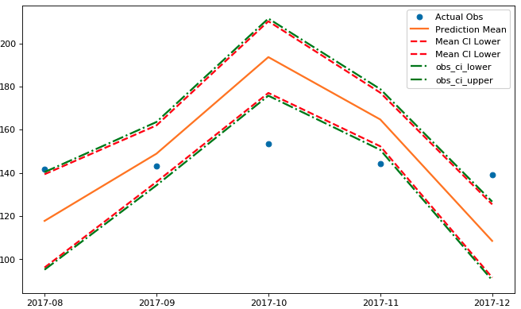
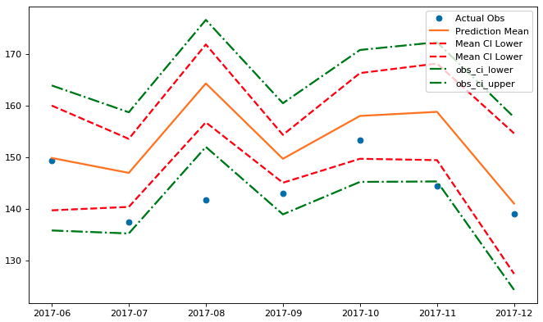
B #1
A #2
C #3
Baseline #1
Prediction Diagnostics
Total Prediction Error | 11.927
Mean Prediction Error | 2.385
Mean Squared Error | 105.28
Prediction Diagnostics
Total Prediction Error | 11.927
Mean Prediction Error | 2.385
Mean Squared Error | 138.88
Prediction Diagnostics
Total Prediction Error | 11.927
Mean Prediction Error | 2.385
Mean Squared Error | 716.41
Prediction Diagnostics
Total Prediction Error | 60.298
Mean Prediction Error | 8.614
Mean Squared Error | 125.637
Notes:
All the prediction diagnostics of final models and baseline models are presented here. We can see that in general final models improved a lot in terms of their total prediction error compared with the baseline model. However, we don’t see much difference among three final models.

Slide 12
VI. Prediction Error
# of Samples: 5
Model B
Total Prediction Error | 11.927
Mean Prediction Error | 2.385
Mean Squared Error | 105.28
Notes:
Here is the smallest prediction I found. And I have 5 samples.

Slide 13
VII. Lessons Learned
DATA
Notes:
The most important thing I have learned from this project is that data is so important. Not only how I source the data but also how I prepare the data for the model. There are many things to consider--time lag, interactions, scales. In this project, collecting data is the most challenging part for me. It’s also difficult to balance the variables I selected based on the theories and those selected by model performance criteria.

